Slide 1
Assignment I
Anna Prince

Slide 2
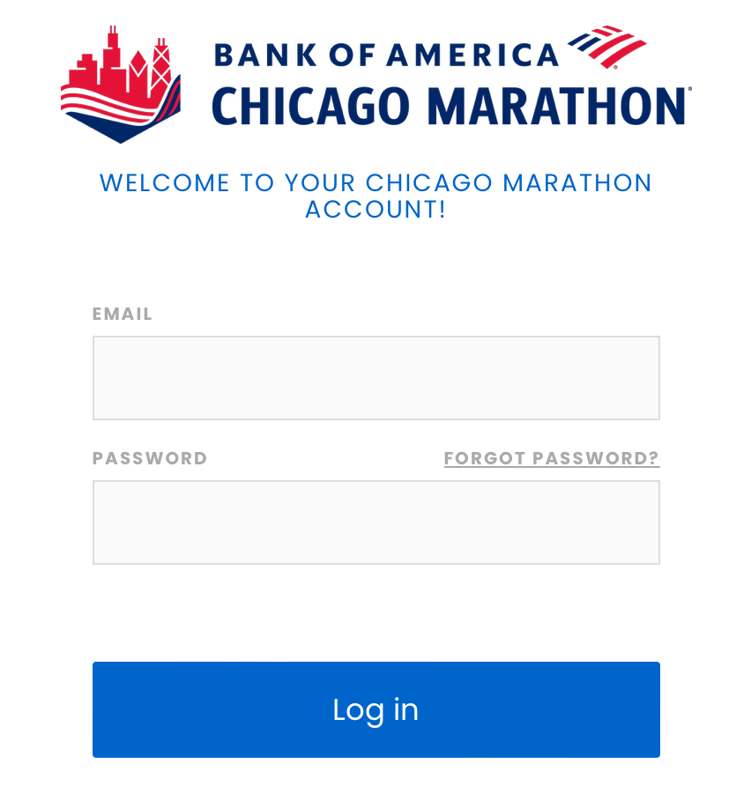
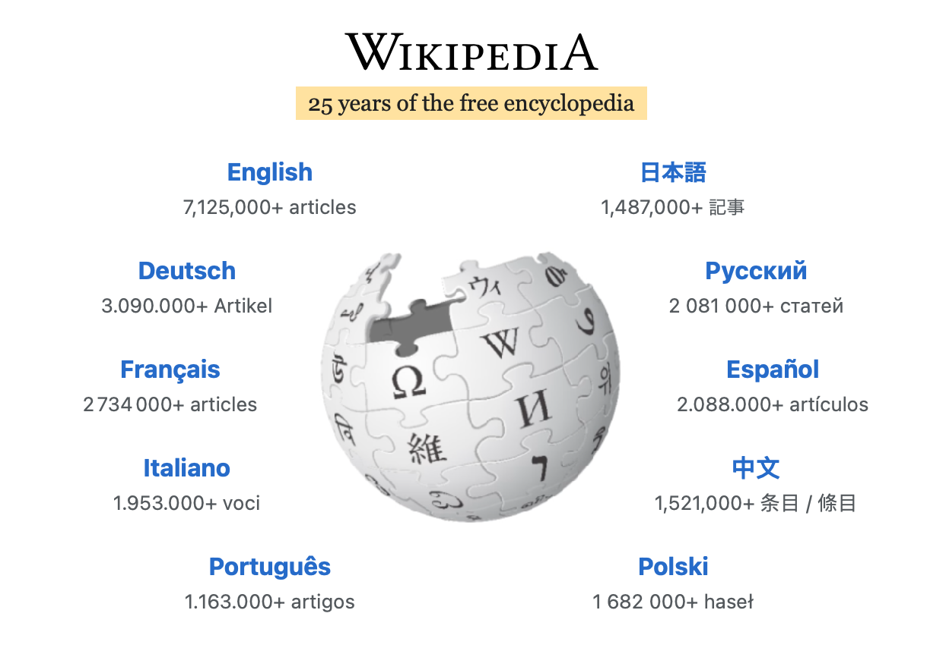
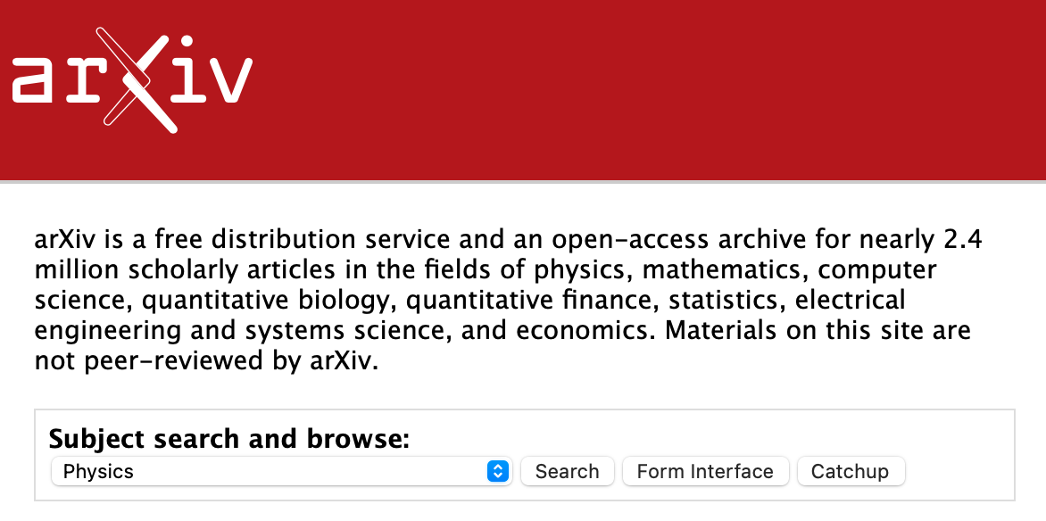
Q1: Databases in my life
Designated research journal/conference hubs
Race signup & results platforms
Crowdsourced information hubs

Slide 3
Proposal | Function | Interface | Existing Example
Database of regional dialects, rarely spoken, or endangered languages. | Facilitate linguistic research for understudied language families or regional dialects. | Search by language or region > similar dialects > speakers for research | Glottolog
Database of neologisms or emerging slang. | Improve auto-translation services or spam/threat reporting. Aid in ethnographic research. | Search by term or community > term meaning > associated communities or dialects > Example usages | Urban Dictionary
Database of understudied language programs | Speed up research participant recruitment or hiring | Search by language,region, or expertise > university affiliation > language focus > other hard skills, etc. | ?
“

Slide 4
Q6: Possible Social Media Tables
“Human-ness”
Handle | Followers | DMs_Sent
@Real_user | 25 | 3
@Fake_User | 4 | 125
Community Moderation
Subreddit | Posts_reported | Posts_removed
r/moderated | 3 | 3
r/unmoderated | 14 | 3
“Interesting” posts
Post | Post_wc | Avg_min_spent_reading
Interesting_Post | 300 | 2
Boring_Post | 500 | .5

Slide 5
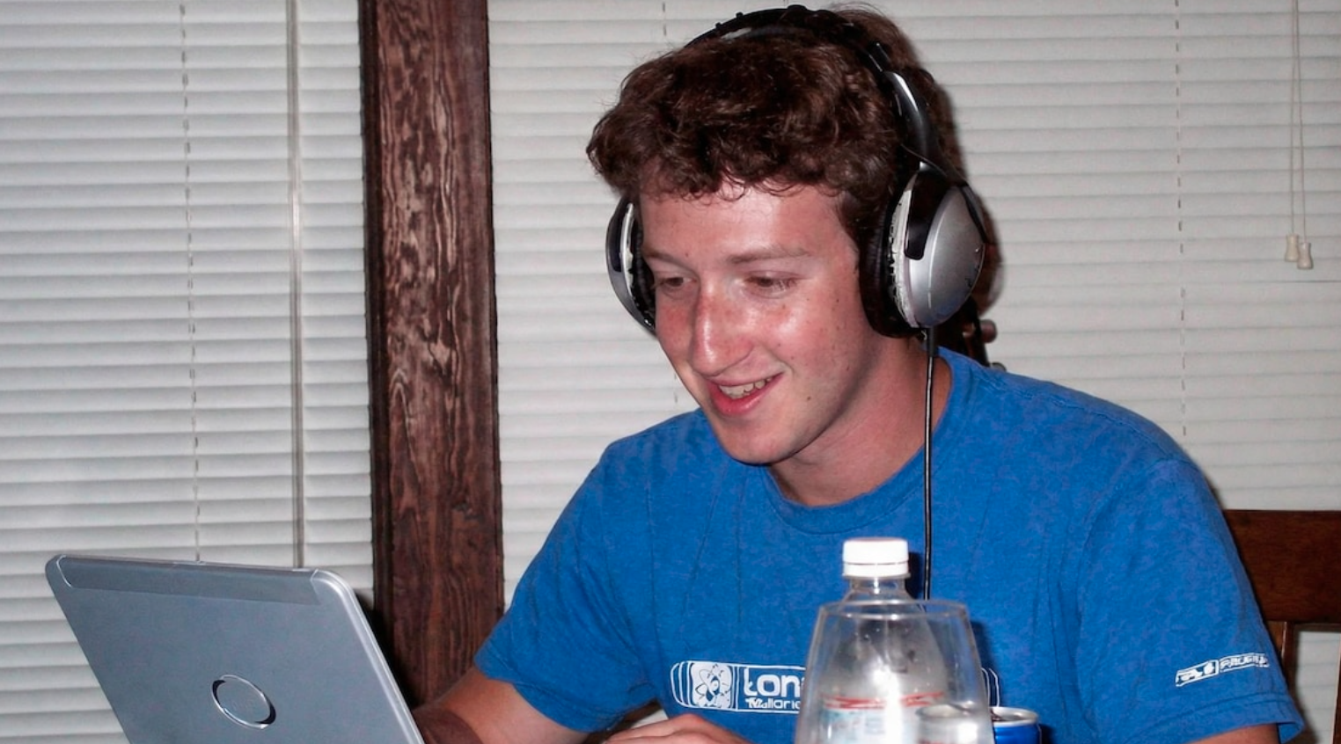
No-SQL versus SQL
SQL | No-SQL
Relational | Non-Relational
Requires consistency | “Eventual consistency”
Row & columns | Diverse formats
Scales vertically | Scales horizontally
2000s: less structured and more diverse data, especially for social media, doesn’t suit table format.

